Slide 1
Server-side Security

Slide 2
WEB security
HTTP
HTML, JavaScript
Same Origin Policy
XSS
CSRF

Slide 3
OWASP Top 10 - 2013
A1-Injection
A2-Broken Authentication and Session Management
A3-Cross-Site Scripting (XSS)
A4-Insecure Direct Object References
A5-Security Misconfiguration
A6-Sensitive Data Exposure
A7-Missing Function Level Access Control
A8-Cross-Site Request Forgery (CSRF)
A9-Using Components with Known Vulnerabilities
A10-Unvalidated Redirects and Forwards
Notes:
https://owasp.org/www-project-top-ten/

Slide 4
OWASP Top 10 – 2017
A1:2017 – Injection
A2:2017 - Broken Authentication
A3:2017 - Sensitive Data Exposure
A4:2017 - XML External Entities (XXE)
A5:2017 - Broken Access Control
A6:2017 - Security Misconfiguration
A7:2017 - Cross-Site Scripting (XSS)
A8:2017 - Insecure Deserialization
A9:2017 - Using Components with Known- Vulnerabilities
A10:2017 - Insufficient Logging & Monitoring

Slide 5
OWASP Top 10 – 2013 vs 2017

Slide 6
Authentication

Slide 7
Password Threats
Threat | Mitigation
Online guessing | Password complexity enforcement Rate limiting for auth requests
Offline guessing | Heavy password hashes High-entropy protocols
Leak of authentication data | Test for leakage: Passwords Reset password tokens
Attacks on “forget password” | “Reset password” High entropy tokens Timeout
Notes:
https://www.owasp.org/index.php/Blocking_Brute_Force_Attacks

Slide 8
Session Management

Slide 9
Notes:
https://cheatsheetseries.owasp.org/cheatsheets/Session_Management_Cheat_Sheet.html
https://xakep.ru/2016/08/11/samsung-pay/

Slide 10
Session ID
Example: employee ID, badge
Session ID (SID) – string of chars or numbers

Slide 11
Session mechanisms
GET
http://site.com/Admin.php?SessionID=12345678
POST
hidden form fields
Cookies
with or without expiration
Custom Headers

Slide 12
Attacks
Hijacking
prediction
brute force
interception
Fixation
Notes:
https://xakep.ru/2016/08/11/samsung-pay/

Slide 13
Session interception
Threat | Cookies | POST | GET
XSS
Insecure server side storage
Web client cookie handling flow
Client cookie cache compromise
Unencrypted transmission
HTTP Referer Session ID leak

Slide 14
Session interception
Threat | Cookies | POST | GET
XSS | ✓ | ✓ | ✓
Insecure server side storage | ✓ | ✓ | ✓
Web client cookie handling flow | ✓
Client cookie cache compromise | ✓
Unencrypted transmission | ✓ | ✓ | ✓
HTTP Referer Session ID leak |  |  | ✓

Slide 15
Session fixation
Attacker creates link with pre-defined session id
Victim uses link to login
Web app uses existing session id
Attacker uses known session id
Notes:
Example: put a duplicated card during shipment

Slide 16
Session Fixation
Threat | Cookies | POST | GET
HTTP Response Splitting | ✓ | ✓ | ✓
XSS | ✓ | ✓ | ✓
Cross-Domain cookie manipulation | ✓
Client cookie cache compromise | ✓

Slide 17
HTTP Response Splitting
HTTP/1.1 302 Found
Date: Sat, 20 Dec 2004 21:27:20 GMT
Location: https://webapp.net/example.com?Name=JohnDoe
Transfer-Encoding: chunked
Content-Type: text/html; charset=UTF-8
…

Slide 18
HTTP Response Splitting
JohnDoe%0d%0aSet-Cookie:%20sessionID%3d1234567
JohnDoe
Set-Cookie: sessionID=1234567

Slide 19
HTTP Response Splitting
HTTP/1.1 302 Found
Date: Sat, 20 Dec 2004 21:27:20 GMT
Location: https://webapp.net/example.com?Name=JohnDoe
Set-Cookie: sessionID=1234567
Transfer-Encoding: chunked
Content-Type: text/html; charset=UTF-8
…

Slide 20
Automatic Session Expiration
Idle Timeout
Absolute Timeout
Renewal Timeout

Slide 21
Session: checks and countermeasures
Strong encryption on all transmissions
Store only ID on client
GET variable Referer filtering
Perform sanity checks to detect hijacking
Notes:
Fingerprinting - http://2016.phdays.ru/program/49626/ - https://youtu.be/uGQROjrmvLw

Slide 22
Access Control

Slide 23
Attacks on Access Control
Vertical Access Control Attacks
A standard user accessing admin functionality
Horizontal Access Control Attacks
User accessing data of another user
Business Logic Access Control Attacks
Abuse of workflow

Slide 24
Insecure Direct Object References
http://example.com/app/accountInfo?acct=notmyacct
Notes:
https://www.owasp.org/index.php/Top_10_2013-A4-Insecure_Direct_Object_References

Slide 25
Insecure Direct Object References
Use per user or session indirect object references
Check access
Notes:
https://www.owasp.org/index.php/Top_10_2013-A4-Insecure_Direct_Object_References

Slide 26
Function Level Access Control
Navigation to unauthorized functions…
Server side authorization missing…
Server side checks rely on user input…
Notes:
https://www.owasp.org/index.php/Top_10_2013-A7-Missing_Function_Level_Access_Control

Slide 27
Authorization HOWTO
Check authorization for every operation
Check authorization for object to operate on
Never rely on client-side authorization
Double-check transaction state on server

Slide 28
Components with Know Vulnerabilities

Slide 29
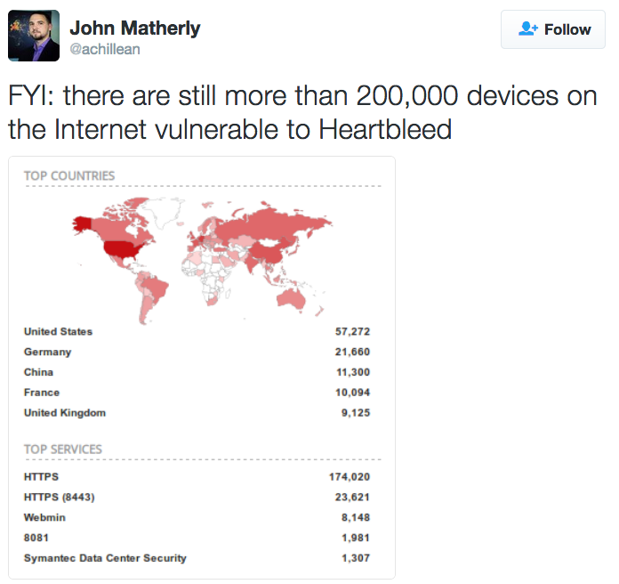
Components with Know Vulnerabilities (2015)
Notes:
https://twitter.com/achillean/status/643706828057018368/photo/1

Slide 30
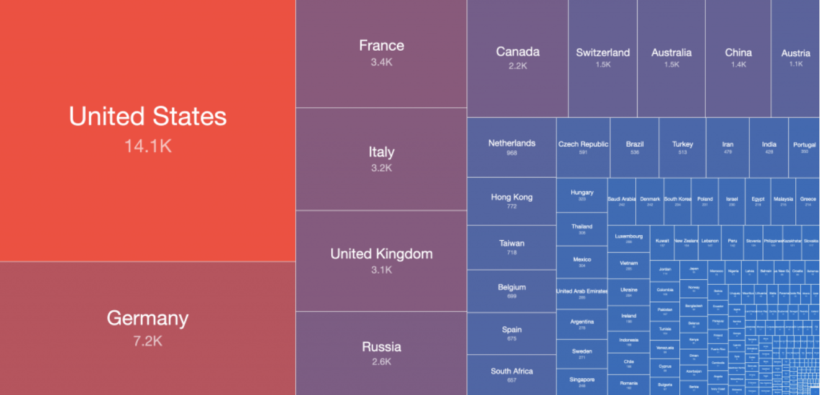
Vulnerable Exchange Servers (2021)
Compromised (2021-03-12)
Vulnerable (2021-03-14)
Notes:
https://www.shadowserver.org/news/shadowserver-special-reports-exchange-scanning-4/

Slide 31
3rd Party Components HOTWO
Evaluate security of new component
Keep registry of 3rd party components
Check for security alerts
Plan dependencies’ upgrades

Slide 32
Insufficient Logging & Monitoring
Auditable events, such as logins, failed logins, and high value transactions are not logged.
Logs of applications and APIs are not monitored for suspicious activity.
Alerting thresholds and response escalation as per the risk of the data held by the application is not in place or effective.
Notes:
https://www.highload.ru/2017/abstracts/3029

Slide 33
Security Misconfiguration
Insecure defaults
Inappropriate/weak tools
Excessive functionality
Too verbose error messages
Notes:
https://www.owasp.org/index.php/Top_10_2013-A5-Security_Misconfiguration
http://projects.webappsec.org/w/page/13246959/Server%20Misconfiguration

Slide 34
Default passwords
Users not aware about default password
Default password seem strong
Users will not change default password

Slide 35
Default passwords
Notes:
http://www.governmentsecurity.org/_/articles/default-logins-and-passwords-for-networked-devices.html
http://www.defaultpassword.com/

Slide 36
Belkin (CVE-2012-4366)
Notes:
http://2014.zeronights.ru/materialy-konferencii.html - Небезопасные заводские настройки и прошивки, Алюшин Виктор, Лаборатория Касперского
http://2014.zeronights.ru/assets/files/slides/viktor.zip
http://opensec.podster.fm/26

Slide 37
Asus Routers Breach
Notes:
http://arstechnica.com/security/2014/02/dear-asus-router-user-youve-been-pwned-thanks-to-easily-exploited-flaw/

Slide 38
DEMO
https://www.shodan.io/
(Don’t forget about ethics)
Notes:
https://www.shodan.io/

Slide 39
Questions?

Slide 40
Thank you!

